Slide 1
Manuscript Plan
Elastic Ti-X binaries-(submitted to Journal of Alloys and Compounds)
Elastic Ti-X-Y-(Dr. Liu editing)-(May 2017)
Ti-Thermodynamic database-(Dr. Zhao editing)-(May 2017)
High-throughput pure elements DFT/CALPAD comparison-(doing calculations)-July 2017
Ti-Nb and Ti-Ta phase stability (writing and doing calculations)- (August 2017)
Defense Date May 10th

Slide 2

Development of a knowledge base of Ti-alloys from first-principles and computational thermodynamics
Cassie Marker
Department of Materials Science and Engineering
Advisor: Dr. Zi-Kui Liu
4/25/17

Slide 3
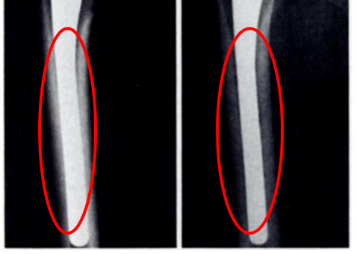
Background: Ti-alloys Biomedical Applications
Ti-Mo-Nb-Ta-Sn-Zr system
Elastic properties
Thermodynamics and phase stability
Alloy | Young’s Modulus (GPa)
Bone | 10-40
Cp-Ti | 105
Ti-6Al-4V | 110
Stainless Steel | 200
CoCrMo | 200-230
A
B
M. Long, H.J. Rack, Biomaterials. 19 (1998) 1621–1639.
Engh C., Bobyn J., Glassman A., Journal of Bone & Joint Surgery, 69 (1987) 45-55.
Notes:
2010 1,061,000 total knee and hip replacements, double by 2020, 14% of hip and 10% of knee replacements were revision surgeries. Focus on biocompatibility fatigue strength, corrosion and young’s modulus

Slide 4
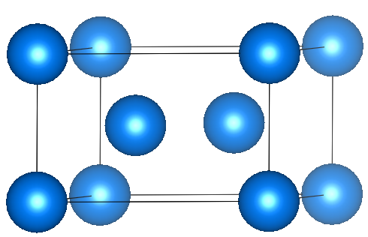
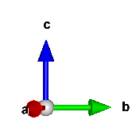
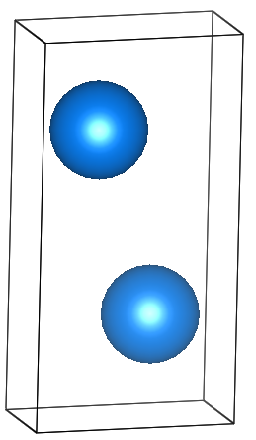
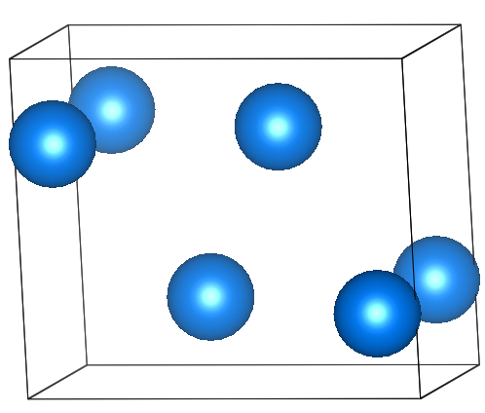
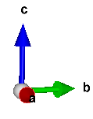
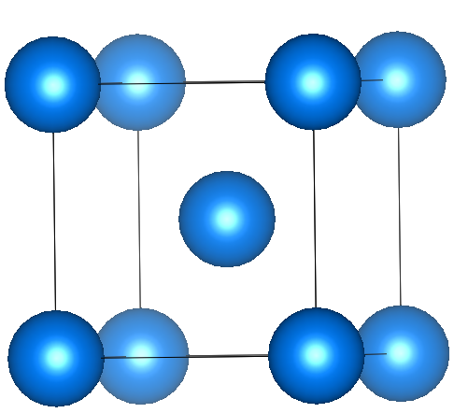
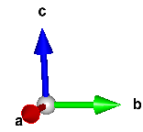
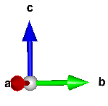
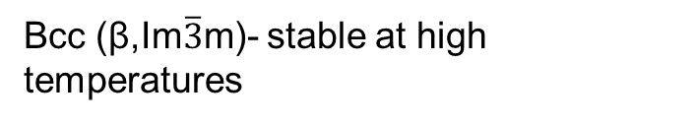
Phase Stabilities
ω (P6/mmm)- hexagonal metastable phase
Hcp (α,P6₃/mmc) Standard element reference state of Ti. Stable at room temperature
Alloy | Phase | Young’s Modulus
Ti | α | 105
Ti-6Al-4V | α+β | 110
Ti-35Nb-5Ta-7Zr | β | 55
Ti-13Nb-13Zr | α“+β | 79
Ti-25Nb-Ta-Zr | α+ω | 88
α“(Cmcm)-orthorhombic martensitic transformation-displacive
Bcc (β,Im$\overline{3}$m)- stable at high temperatures
A. Jain*, S.P. Ong*, G. Hautier, W. Chen, W.D. Richards, S. Dacek, S. Cholia, D. Gunter, D. Skinner, G. Ceder, K.A. Persson APL Materials, 2013, 1(1), 011002.
M. Long, H.J. Rack, Biomaterials. 19 (1998) 1621–1639.

Slide 5
Objectives
Study equilibrium phase stability
Establish a thermodynamic and elastic database for the Ti-Mo-Nb-Sn-Ta-Zr system
Study metastable phase stability
Study the elastic properties, phase stability and transformation of α” and ω phases

Slide 6
Objectives
Study equilibrium phase stability
Establish a thermodynamic and elastic database for the Ti-Mo-Nb-Sn-Ta-Zr system
Study metastable phase stability
Study the elastic properties, phase stability and transformation of α” and ω phases

Slide 7
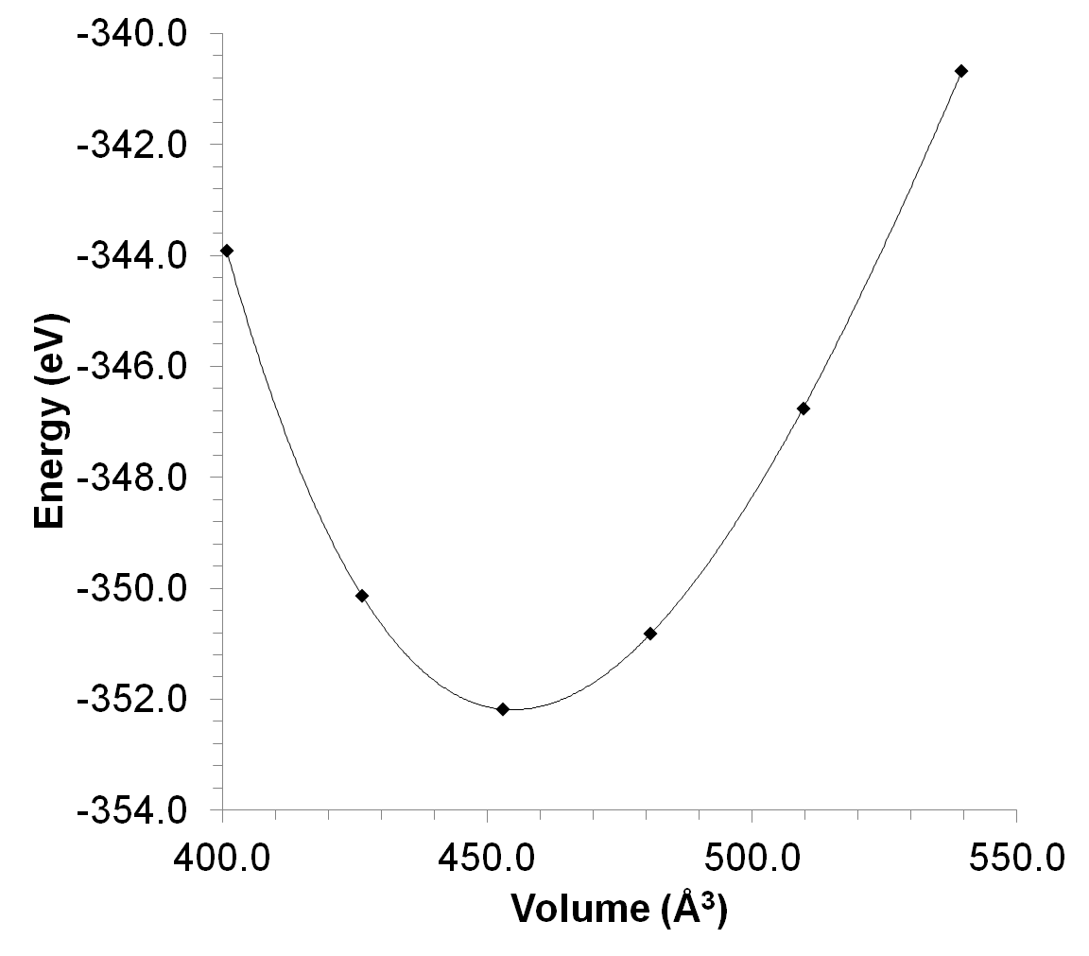
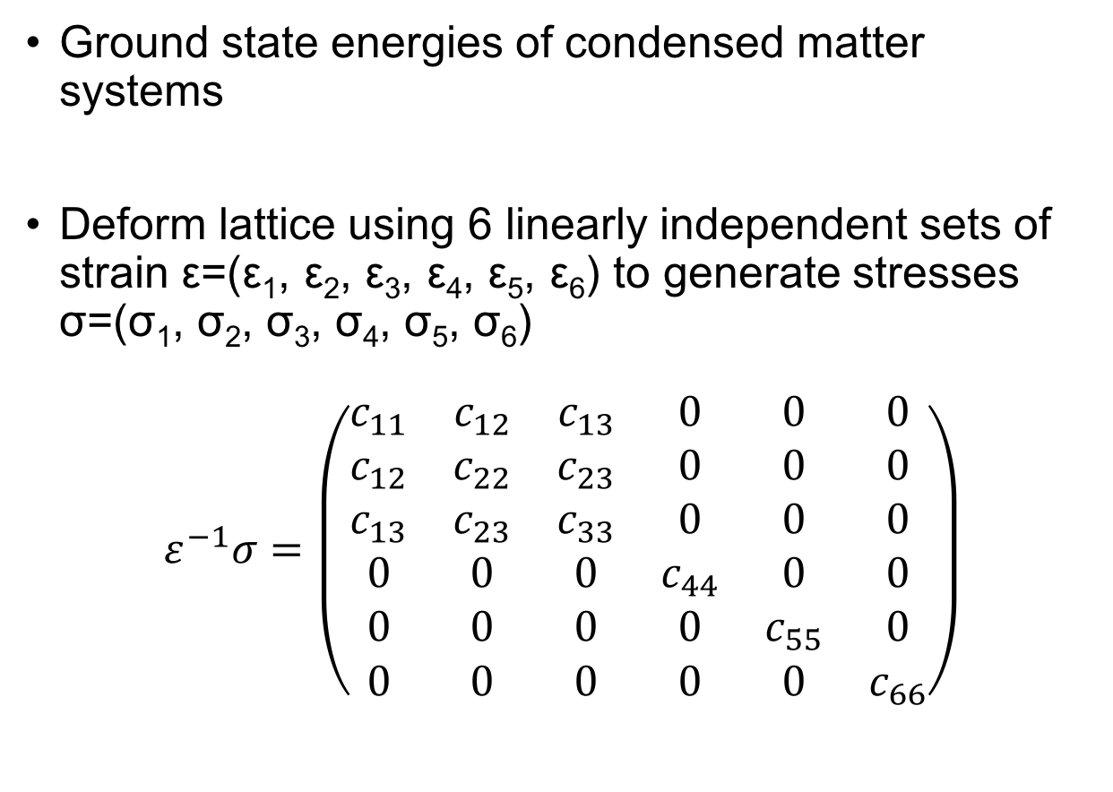
First-principles based on DFT 0 K
E_{0K} EOS fitting: static ground state energy of the crystal
Ground state energies of condensed matter systems
Deform lattice using 6 linearly independent sets of strain ε=(ε₁, ε₂, ε₃, ε₄, ε₅, ε₆) to generate stresses σ=(σ₁, σ₂, σ₃, σ₄, σ₅, σ₆)
$$ε^{−1}σ=\left(\begin{matrix}c_{11} & c_{12} & c_{13} & 0 & 0 & 0 \\ c_{12} & c_{22} & c_{23} & 0 & 0 & 0 \\ c_{13} & c_{23} & c_{33} & 0 & 0 & 0 \\ 0 & 0 & 0 & c_{44} & 0 & 0 \\ 0 & 0 & 0 & 0 & c_{55} & 0 \\ 0 & 0 & 0 & 0 & 0 & c_{66}\end{matrix}\right)$$
S.L. Shang et al., Comput. Mater. Sci. 47 (2010) 1040–1048.; Y. Wang et al., Acta Mater. 52 (2004) 2665–2671.; A. Wang et al., Calphad. 37 (2012) 126–131.
Notes:
where E₀ is the static contribution at 0 K without the contribution of zero-point vibrational energy, F_{Vib} the temperature-dependent vibrational contribution, and F_{T-el} the thermal electronic contribution. At ambient pressure, the Helmholtz energy of the system is equal to the Gibbs energy, which is used in the CALPHAD modeling F_{T-el} based on electronic density of states and calculated with Fermi-Dirac statistics E_{el}-Ts_{el}

Slide 8
First-principles based on DFT finite temperature
$$F\left(V,T\right)=E_{0K}\left(V\right)+F_{vib}\left(V,T\right)+F_{T−el}\left(V,T\right)$$
Temperature-dependent crystal vibrations, obtained from the Debye-Grüneisen model or phonon supercell approach
F_{Vib}(V,T)
F_{T-el}(V,T)
Temperature-dependent thermal-electronic excitation contributions to the free energy
S.L. Shang et al., Comput. Mater. Sci. 47 (2010) 1040–1048.; Y. Wang et al., Acta Mater. 52 (2004) 2665–2671.; A. Wang et al., Calphad. 37 (2012) 126–131.
Notes:
where E₀ is the static contribution at 0 K without the contribution of zero-point vibrational energy, F_{Vib} the temperature-dependent vibrational contribution, and F_{T-el} the thermal electronic contribution. At ambient pressure, the Helmholtz energy of the system is equal to the Gibbs energy, which is used in the CALPHAD modeling F_{T-el} based on electronic density of states and calculated with Fermi-Dirac statistics E_{el}-Ts_{el}

Slide 9

CALculations of PHAse Diagrams (CALPHAD)
Fewer data points supplemented by first-principles calculations
Experimental data plenty, hard to predict using first-principles
Thermochemical data: enthalpy entropy, heat capacity, activity …
Phase equilibria data: liquidus, solidus, phase boundary/composition
Gibbs energy (parameterized)
Practical applications: T, P, ni
Phase diagrams, direct applications
http://www.calphad.org
$$G_{m}^{∅}=x_{i}{}_{}^{0}{G_{i}^{∅}+x_{j}{}_{}^{0}{G_{j}^{∅}+RT\left[x_{i}\ln\left(x_{i}\right)+x_{j}\ln\left(x_{j}\right)\right]+{}_{}^{XS}{G_{m}^{∅}}}}$$
Z.-K. Liu, J. Phase Equilibria Diffus. 30 (2009) 517–534.; Z.-K. Liu, H. Zhang, S. Ganeshan, Y. Wang, S.N. Mathaudhu, Scr. Mater. 63 (2010) 686–691.

Slide 10
Ti-Mo-Nb-(Sn)-Ta-Zr Database Objectives
Pure elements → Binary → Ternary → Multi-component
Ti-Mo
Ti-Nb
Ti-Sn
Ti-Ta
Ti-Zr
Mo-Nb
Mo-Sn
Mo-Ta
Nb-Sn
Nb-Ta
Nb-Zr
Sn-Ta
Sn-Zr
Ta-Zr
Mo-Zr
Ti-Mo-Nb
Ti-Mo-Ta
Ti-Mo-Zr
Ti-Nb-Ta
Ti-Nb-Zr
Ti-Ta-Zr
Literature
New
Future

Slide 11
Thermodynamic Modeling- Pure Elements
Pure Elements |  | V0 (A/atom) | E0 (eV/atom) | B (GPa) | B’
hcp-Ti | This work | 17.37 | -7.80 | 113 | 3.54
 | Expt [1] |  |  | 110
Bcc-Mo | This work | 15.91 | -10.84 | 262 | 4.37
 | Expt [2] |  |  | 261
Bcc-Nb | This work | 18.14 | -10.22 | 171 | 3.78
 | Expt [3] |  |  | 172
Bcc-Ta | This work | 18.32 | -11.85 | 196 | 4.32
 | Expt [3] |  |  | 196
hcp-Zr | This work | 23.44 | -8.51 | 94 | 3.13
 | Expt [4] |  |  | 97
[1] M. J. and N. Z. and M. N. and A. J. and M. Lame, Phys. Scr., vol. 83, no. 6, p. 65603, 2011. [2] J.M. Dickinson, P.E. Armstrong, J. Appl. Phys. 38 (1967) 602–606.; [3] D.I. Bolef, J. Appl. Phys. 32 (1961) 100–105. [4] Q. Peng et al., Sci. Rep., vol. 4, p. 5735, Jul. 2014.

Slide 12
Thermodynamic Modeling-Binary Systems
T. Uesugi, S. Miyamae, K. Higashi, Mater. Trans. 54 (2013) 484–492.

Slide 13
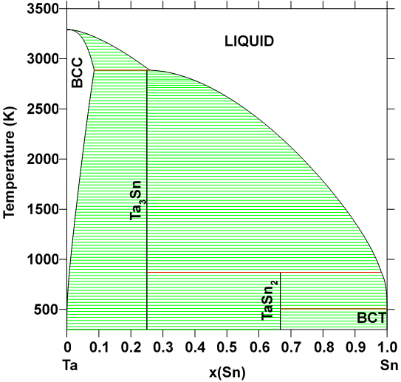
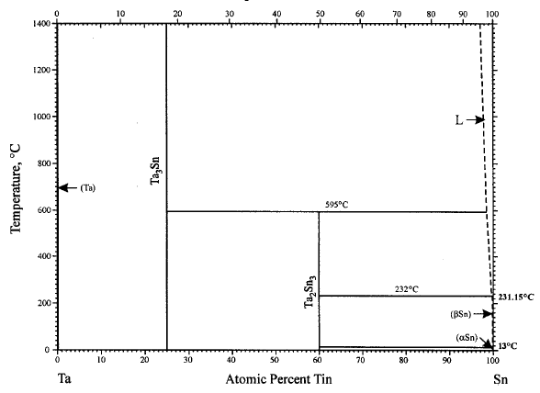
Ta-Sn Thermodynamic Modeling
Observed Phases: bct Sn, diamond Sn, bcc, Ta₃Sn, TaSn₂
H. Okamoto, Sn-Ta (Tin-Tantalum), J. Phase Equilibria. 24 (2003) 484.

Slide 14
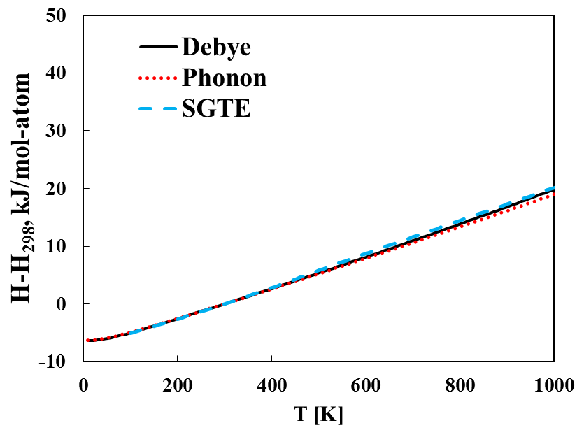
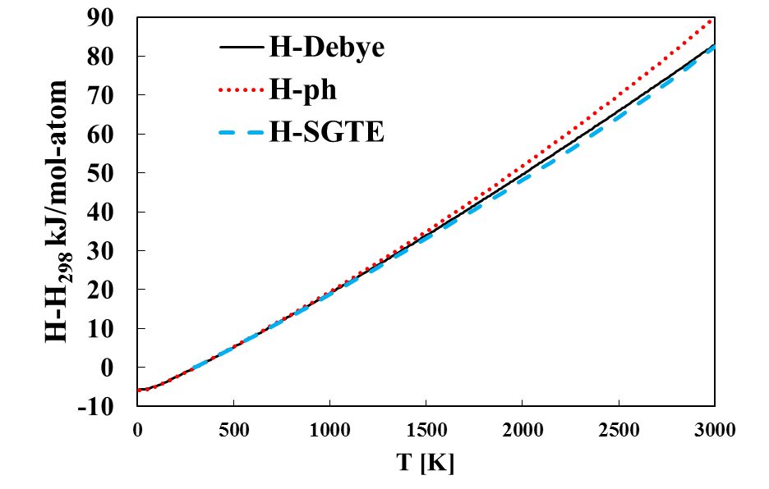
Calculated the pure elements
Bcc Ta
Bct Sn
A.T. Dinsdale, CALPHAD. 15 (1991) 317–425.

Slide 15
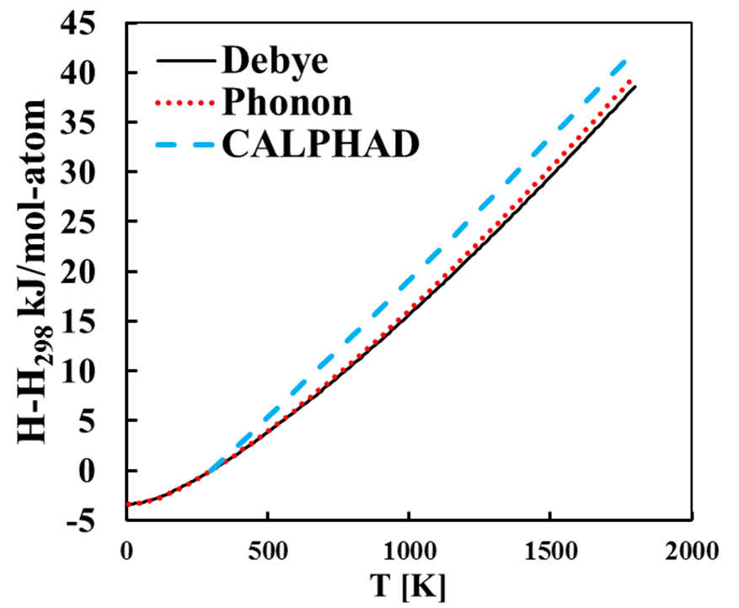
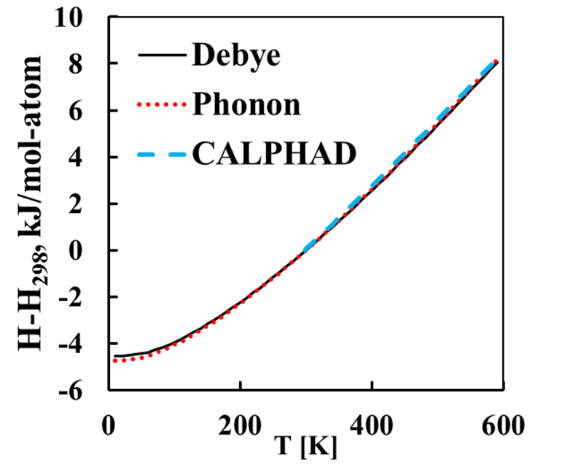
Calculated the Stoichiometric compounds
Ta₃Sn
TaSn₂

Slide 16
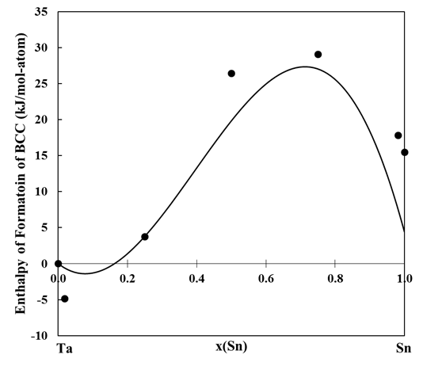
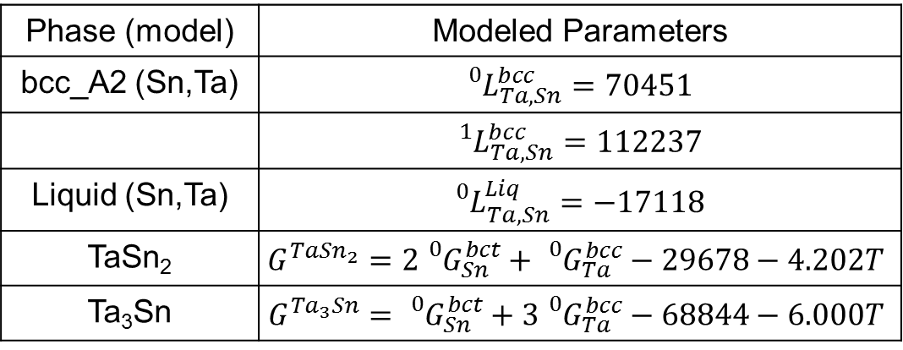
Enthalpy of Formation and Modeled Parameters
Phase (model) | Modeled Parameters
bcc_A2 (Sn,Ta) | $${}_{}^{0}{L_{Ta,Sn}^{bcc}=70451}$$
 | $${}_{}^{1}{L_{Ta,Sn}^{bcc}=112237}$$
Liquid (Sn,Ta) | $${}_{}^{0}{L_{Ta,Sn}^{Liq}=−17118}$$
TaSn₂ | $$G^{Ta{Sn}_{2}}=2{}_{}^{0}{G_{Sn}^{bct}+{}_{}^{0}{G_{Ta}^{bcc}}−29678−4.202T}$$
Ta₃Sn | $$G^{{Ta}_{3}Sn}={}_{}^{0}{G_{Sn}^{bct}+3{}_{}^{0}{G_{Ta}^{bcc}}−68844−6.000T}$$

Slide 17
Thermodynamic Modeling-Ti-X-Y
o-phase boundary
•-single-phase
◑-two-phase
673 K
823 K
Phase | Parameters | Value
BCC_A2 (Nb,Ta,Ti) |  | -136603
 |  | -136602
673 K
823 K
L. Na, W.H. Warnes, Ieee Trans. Appl. Supercond. 11 (2001) 3800–3803.

Slide 18
Elastic Modeling- Pure Elements
Pure Elements |  | C₁₁ (GPa) | C₁₂ (GPa) | C₄₄ (GPa) | B (GPa)
Bcc-Ti | This work | 93 | 115 | 41 | 107
 | FP [1] | 96 | 116 | 40 | 107
Bcc-Mo | This work | 475 | 164 | 108 | 268
 | Expt [2] | 473 | 160 | 109 | 261
Bcc-Nb | This work | 245 | 144 | 27 | 178
 | Expt [3] | 247 | 135 | 29 | 172
Bcc-Ta | This work | 278 | 164 | 81 | 202
 | Expt [3] | 267 | 161 | 83 | 196
Bcc-Sn | This work | 50 | 52 | 29 | 52
 | FP [1] | 30 | 60 | 18 | 48
Bcc-Zr | This work | 86 | 91 | 32 | 89
 | FP [1] | 82 | 94 | 30 | 90
[1] S.L. Shang et al., Comput. Mater. Sci. 48 (2010) 813–826.; [2] J.M. Dickinson et al., J. Appl. Phys. 38 (1967) 602–606.; [3] D.I. Bolef, Appl. Phys. 32 (1961) 100–105.

Slide 19
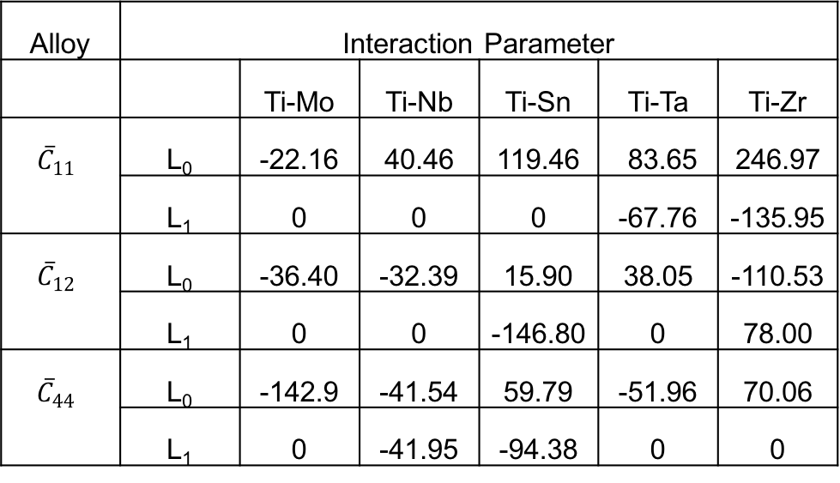
Elastic Modeling- Ti-X C_{ij}
Alloy | Interaction Parameter
 |  | Ti-Mo | Ti-Nb | Ti-Sn | Ti-Ta | Ti-Zr
$${\overline{C}}_{11}$$ | L₀ | -22.16 | 40.46 | 119.46 | 83.65 | 246.97
 | L₁ | 0 | 0 | 0 | -67.76 | -135.95
$${\overline{C}}_{12}$$ | L₀ | -36.40 | -32.39 | 15.90 | 38.05 | -110.53
 | L₁ | 0 | 0 | -146.80 | 0 | 78.00
${\overline{C}}_{44}$ | L₀ | -142.9 | -41.54 | 59.79 | -51.96 | 70.06
 | L₁ | 0 | -41.95 | -94.38 | 0 | 0
H. Ikehata, N. Nagasako, T. Furuta, A. Fukumoto, K. Miwa, T. Saito, Phys. Rev. B. 70 (2004) 174113.

Slide 20
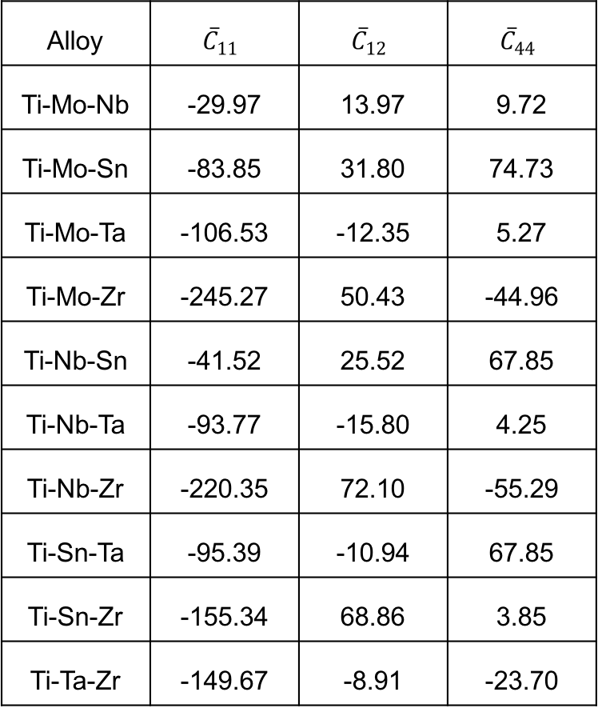
Elastic Modeling- Ti-X-Y C_{ij}
Alloy | $${\overline{C}}_{11}$$ | $${\overline{C}}_{12}$$ | $${\overline{C}}_{44}$$
Ti-Mo-Nb | -29.97 | 13.97 | 9.72
Ti-Mo-Sn | -83.85 | 31.80 | 74.73
Ti-Mo-Ta | -106.53 | -12.35 | 5.27
Ti-Mo-Zr | -245.27 | 50.43 | -44.96
Ti-Nb-Sn | -41.52 | 25.52 | 67.85
Ti-Nb-Ta | -93.77 | -15.80 | 4.25
Ti-Nb-Zr | -220.35 | 72.10 | -55.29
Ti-Sn-Ta | -95.39 | -10.94 | 67.85
Ti-Sn-Zr | -155.34 | 68.86 | 3.85
Ti-Ta-Zr | -149.67 | -8.91 | -23.70

Slide 21
Calculation of the Young’s modulus
H. Ikehata, N. Nagasako, T. Furuta, A. Fukumoto, K. Miwa, T. Saito, Phys. Rev. B. 70 (2004) 174113.; T. Ozaki, H. Matsumoto, S. Watanabe, S. Hanada, Mater. Trans. 45 (2004) 2776–2779.; R.R. Boyer, G. Welsch, E.W. Collings, ASM Int. Mater. Park. OH. (1994).; M.T. Mohammed, Z.A. Khan, A.N. Siddiquee, Int. J. Chem. Mol. Nucl. Mater. Metall. Eng. 8 (2014) 788–793.; F. Nozoe, H. Matsumoto, T.K. Jung, S. Watanabe, T. Saburi, S. Hanada, Mater. Trans. 48 (2007) 3007–3013.; M. Niinomi, M. Nakai, J. Hieda, Acta Biomater. 8 (2012) 3888–3903.

Slide 22
Ensuring Database Accuracy
Database Comparison
Binary interaction parameters- 0.69 to 14 GPa on average variance of 7 Gpa
Ternary interaction parameters-0.39 to 13 GPa on average variance of 5 GPa
M. Tane, S. Akita, T. Nakano, K. Hagihara, Y. Umakoshi, M. Niinomi, H. Mori, H. Nakajima, Acta Mater. 58 (2010) 6790–6798.; M.T. Mohammed, Z.A. Khan, A.N. Siddiquee, Int. J. Chem. Mol. Nucl. Mater. Metall. Eng. 8 (2014) 788–793.; M. Geetha, A.K. Singh, R. Asokamani, A.K. Gogia, Prog. Mater. Sci. 54 (2009) 397–425.

Slide 23
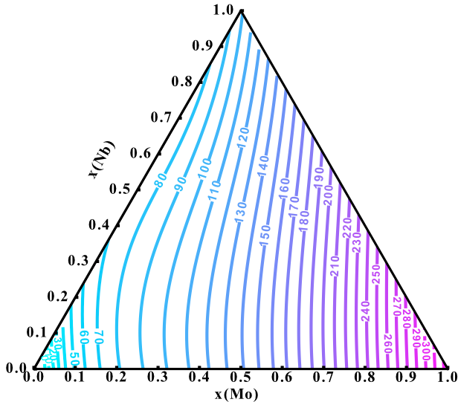
Young’s Modulus Mapping from the Database
R. Otis, Z.-K. Liu, J. Open Res. Softw. 5 (2017) 1–11.

Slide 24
Objectives
Study equilibrium phase stability
Establish a thermodynamic and elastic database for the Ti-Mo-Nb-Sn-Ta-Zr system
Study metastable phase stability
Study the elastic properties, phase stability and transformation of α” and ω phases

Slide 25
Metastable phase formation-effects E
Y. L. Zhou, M. Niinomi, and T. Akahori, Mater. Sci. Eng. A, vol. 371, no. 1–2, pp. 283–290, Apr. 2004.; Y.-L. Zhou and M. Niinomi, Mater. Sci. Eng. C, vol. 29, no. 3, pp. 1061–1065, Apr. 2009.; H. Ikehata, N. Nagasako, T. Furuta, A. Fukumoto, K. Miwa, and T. Saito, Phys. Rev. B, vol. 70, no. 17, p. 174113, 2004.; S. G. Fedotov, T. V. Chelidze, Y. K. Kovneristyy, and V. Sanadze, Phys. Met. Met., vol. 60, no. 3, pp. 139–143, 1985.; S. G. Fedotov and O. K. Belousov, Dokl. Akad. Nauk SSSR, vol. 150, no. 1, p. 77-, 1963.; C. Y. Wu, Y. H. Xin, X. F. Wang, and J. G. Lin, Solid State Sci., vol. 12, no. 12, pp. 2120–2124, Dec. 2010.; A. N. Timoshevskii, S. O. Yablonovskii, and O. M. Ivasishin, arXiv Prepr. arXiv1111.7182, 2011.; T. Ozaki, H. Matsumoto, S. Watanabe, and S. Hanada, Mater. Trans., vol. 45, no. 8, pp. 2776–2779, 2004.; M. Friák et al., Materials (Basel)., vol. 5, no. 10, pp. 1853–1872, 2012.; R. Karre, M. K. Niranjan, and S. R. Dey, Mater. Sci. Eng. C, vol. 50, pp. 52–58, May 2015.; H. Matsumoto, S. Watanabe, N. Masahashi, and S. Hanada, Metall. Mater. Trans. A, vol. 37, no. 11, pp. 3239–3249, 2006.

Slide 26
Ti-Nb Elastic Data
H.Y. Kim, Y. Ikehara, J.I. Kim, H. Hosoda, S. Miyazaki, Acta Mater. 54 (2006) 2419–2429.

Slide 27
Young’s Modulus predicted with phase fractions
All hcp < 10 at. % Nb
Predicted within 8 Gpa
10-30 at. % Nb mixture
bcc+alpha”
Predicted within 0.52 Gpa
hcp+bcc
Predicted within 22 Gpa
All bcc > 30 at. % Nb
Predicted within 7 GPa
A. N. Timoshevskii, S. O. Yablonovskii, and O. M. Ivasishin, arXiv Prepr. arXiv1111.7182, 2011.; T. Ozaki, H. Matsumoto, S. Watanabe, and S. Hanada, Mater. Trans., vol. 45, no. 8, pp. 2776–2779, 2004.; M. Friák et al., Materials (Basel)., vol. 5, no. 10, pp. 1853–1872, 2012.; R. Karre, M. K. Niranjan, and S. R. Dey, Mater. Sci. Eng. C, vol. 50, pp. 52–58, May 2015.; H. Matsumoto, S. Watanabe, N. Masahashi, and S. Hanada, Metall. Mater. Trans. A, vol. 37, no. 11, pp. 3239–3249, 2006.

Slide 28
Phase Stability at 0 K of Ti-Nb and Ti-Ta

Slide 29
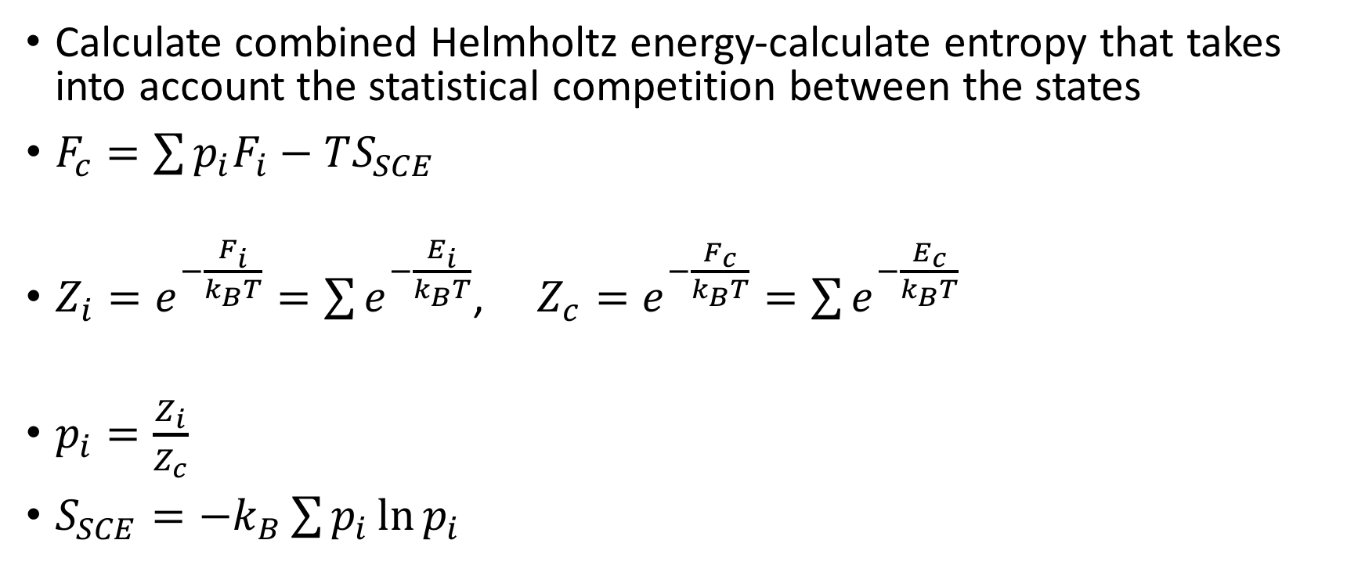
Partition Function Approach
Calculate combined Helmholtz energy-calculate entropy that takes into account the statistical competition between the states
$F_{c}=\sum{p_{i}F_{i}−TS_{SCE}}$
$Z_{i}=e^{−\frac{F_{i}}{k_{B}T}}=\sum{e^{−\frac{E_{i}}{k_{B}T}}}$, $Z_{c}=e^{−\frac{F_{c}}{k_{B}T}}=\sum{e^{−\frac{E_{c}}{k_{B}T}}}$
$p_{i}=\frac{Z_{i}}{Z_{c}}$
$S_{SCE}=−k_{B}\sum{p_{i}\ln{p_{i}}}$

Slide 30
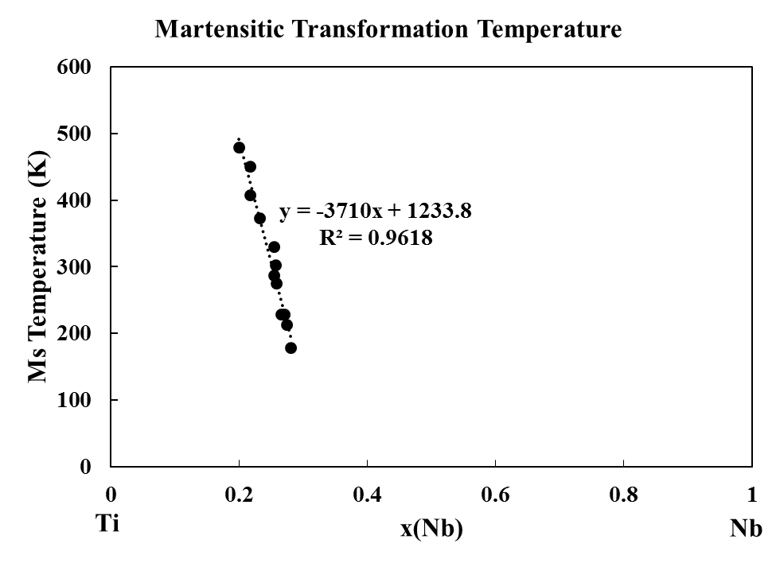
Ti-Nb Martensite
Practicing taking neutron ARCS data and converting it to DOS
4 compositions x(Nb)=0.1, 0.12, 0.18, 0.2
Two- 2 in by 2 in samples for each compostion
1 sample at each composition will be annealed and cold water quenched
Only studied at 300 K
1 sample will be annealed
Studied at 1110, 900 500, 300 K
y=0 at x=0.33
H.Y. Kim, Y. Ikehara, J.I. Kim, H. Hosoda, S. Miyazaki, Acta Mater. 54 (2006) 2419–2429.

Slide 32
Entropy difference between slow cooled and quenched samples
Phonon DOS show differences which concludes that they formed the different phases expected
Entropy difference between samples increases with increasing Nb
Further investigation is required to explain

Slide 33
Ti-Nb Diffraction Patterns and phase fractions
Alloy | x(Nb) | Phase Fraction
 |  | bcc | omega | Alpha”
Quenched | 0.10 | 0.12 | - | 0.88
 | 0.12 | 0.20 | - | 0.80
 | 0.18 | 0.57 | - | 0.43
 | 0.20 | 0.70 | - | 0.30
Slow Cooled | 0.10 | 0.20 | 0.80 | -
 | 0.12 | 0.30 | 0.70 | -
 | 0.18 | 0.60 | 0.40 | -
 | 0.20 | 0.70 | 0.30 | -
Alloy | x(Nb) | Phase Fraction
 |  | bcc | Alpha”
Friak | 0.10 | 0.06 | 0.94
 | 0.12 | 0.60 | 0.40
M. Friák et al., Materials (Basel)., vol. 5, no. 10, pp. 1853–1872, 2012.;

Slide 34
Summary
Established a thermodynamic database to predict the phase stabilities in the Ti-Mo-Nb-(Sn)-Ta-Zr system
Established a elastic database to predict the elastic properties of the BCC phase of the Ti-Mo-Nb-Sn-Ta-Zr system
Studied the elastic properties, phase stability and transformation of α” and ω phases

Slide 35
Future Work
Finish the thermodynamic modeling of the Sn binary and ternary systems
Introduce the hcp phase and interaction parameters for the non-Ti containing systems to the elastic database
Continue working on the theoretic framework for predicting the formation of metastable phases
Study the type of transformation taking place for the metastable phases by doing temperature dependent neutron scattering

Slide 36
Acknowledgements
Dr. Liu, Shunli and Dr. Zhao
Funding Sources
DOE- Science Graduate Research Award
NSF-NRT funding
NSF-Ti Grant 1333999
NSF Grant No. ACI-1053575
DOE Grant No. DE-AC02-05CH11231

